Slide 1

Remote Ad Hoc Sensor Networks
Li-Wen Yip
B.Engimaneering (Computer Systems), James Cook University
Notes:
0:20
Greeting + Introduction

Slide 2

Remote Ad Hoc Sensor Networks
Introduction
Notes:
0:05

Slide 3



Project Overview
Australia is a huuuuge country
Remote and inaccessible locations
Challenging communication scenarios
An alternative approach: Ad Hoc Networking
Notes:
0:30 (0:45)

Slide 4
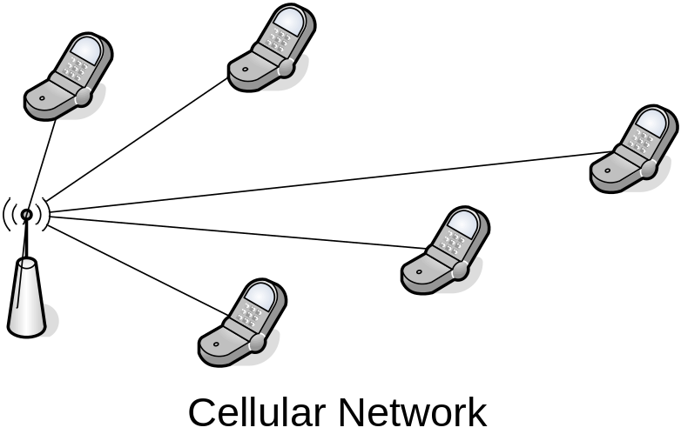
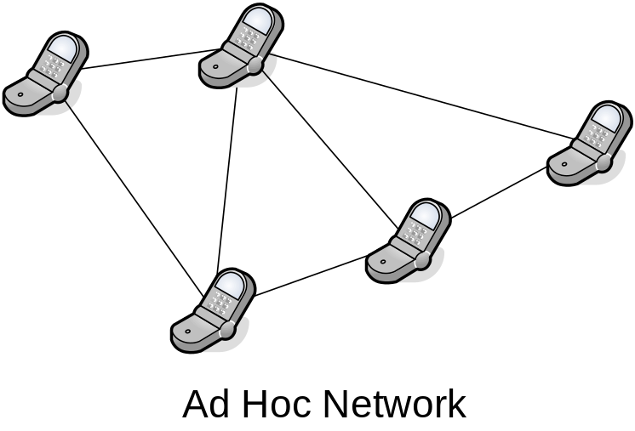
What is an Ad-Hoc Network?
Peer to peer network
Distributed infrastructure
Automatic and adaptive configuration
Energy efficient
Notes:
0:40 (1:25)

Slide 5
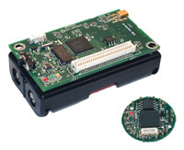
Typical Ad Hoc Sensor Networks
Network Conditions
  Dense, well connected topologies
  Low traffic rates
Tiny sensor nodes
  Data collection
  Data processing
  Low power radios
Long battery life
Crossbow “Mica” Motes

Slide 6

Remote Ad Hoc Sensor Networks
Size
  Large geographical areas
  Remote and inaccessible locations
Network Conditions
  Sparse, minimally connected topologies
  Large link distances (up to 10km)
  Exposure to environmental conditions

Slide 7

Applications
Data collection
  Great Barrier Reef monitoring stations
  Water trough monitoring on cattle properties
Rapidly deployable communications
  Natural disasters
  Battlefields
Davies Reef
Remote Weather Station

Slide 8
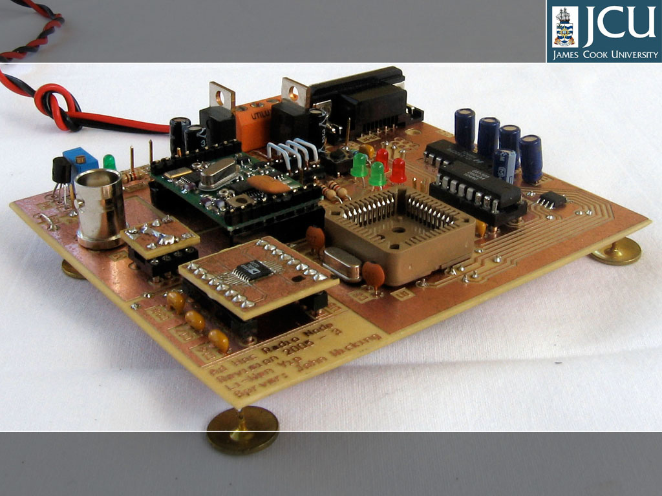
Remote Ad Hoc Sensor Networks
Hardware

Slide 9
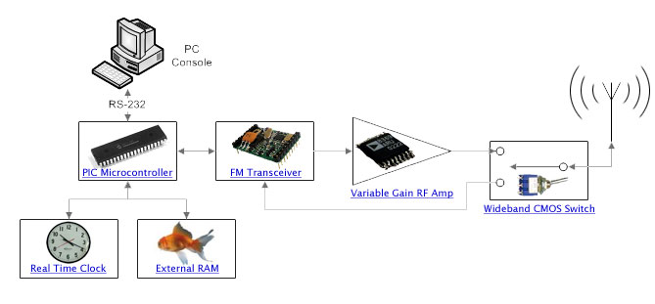
Hardware Overview
Microcontroller based (PIC18C452)
Programmable output power
Cache routing information
Schedule sleep periods
CMOS Switch only consumes 5μA

Slide 10
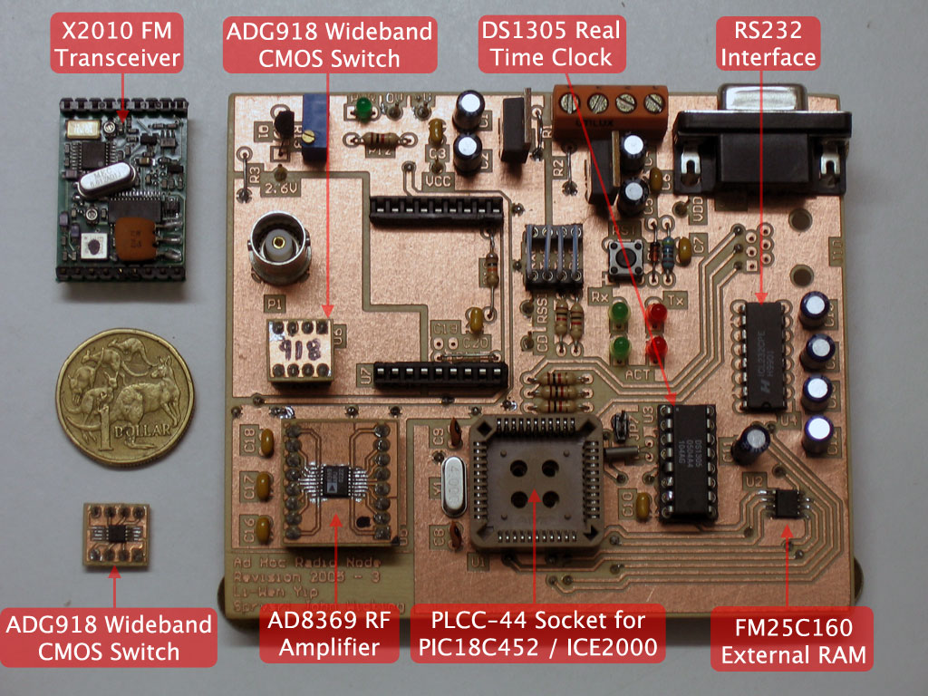
Here’s one I prepared earlier…

Slide 11
Remote Ad Hoc Sensor Networks
Software

Slide 12
Software
Manchester Encoding/Decoding
Power Saving Techniques
Dynamic Address Allocation

Slide 13
Manchester Encoding / Decoding
Manchester Clock
NRZ Binary Signal
1
0
0
1
1
1
0
1
Manchester Coded Signal
1 Bit Period
1 Chip Period
1 -> 10; 0 -> 01
Required for the X2010 FM Transceiver

Slide 14
Manchester Encoding
Interrupt Occurs
Set Chip 0
Interrupt Occurs
Set Chip 1
Interrupt Occurs
Set Chip 2
Interrupt Occurs
Set Chip 3
Calc Chip 1
Calc Chip 1
Calc Chip 2
Calc Chip 2
Calc Chip 3
Calc Chip 3
Calc Chip 4
Calc Chip 4
Each change is calculated in advance and scheduled
Not dependent on calculation time
Allows for some slack
Perform data fetching under interrupt

Slide 15
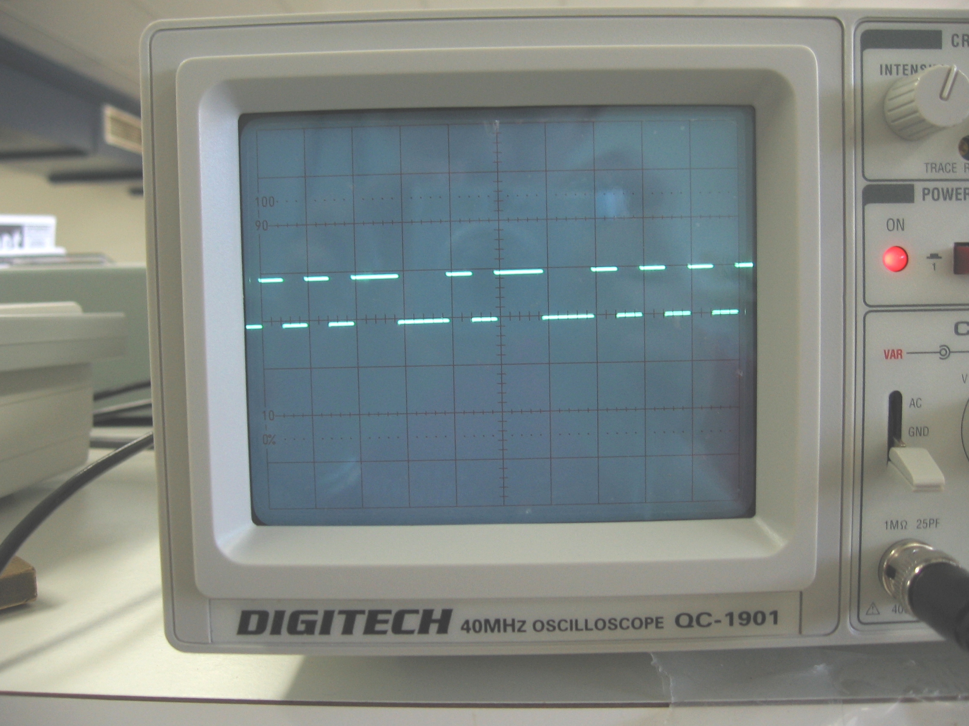
Manchester Encoding

Slide 16
Manchester Decoding
1.5 Chip Times
1.5 Chip Times
1.5 Chip Times
1.5 Chip Times
1
0
0
1
Capture Edge
Take Sample
Encoded Clock
Previous method involved start and stop bits
Synchronise to the encoded clock
Locks as soon as the data bit changes
Extremely efficient – runs at 9.6 kbps

Slide 17
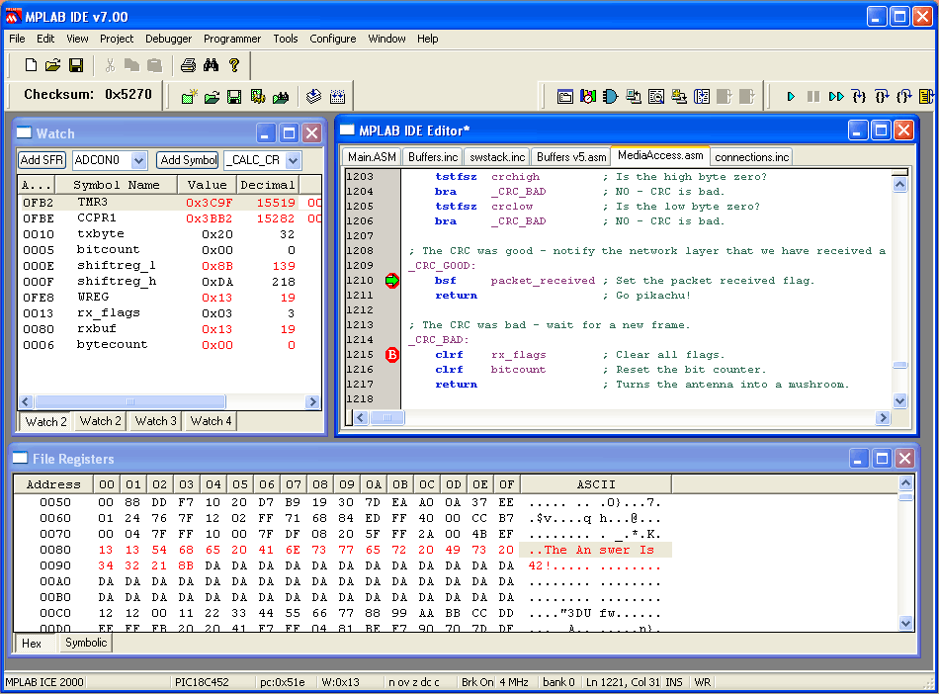
Manchester Decoding

Slide 18
Clock Detection
Edge Expected
0
1
1
0
Encoded Clock
Detect Clock
Clock Error
Detect if a valid signal is present
Check that edges occur regularly
Timer overflows -> clock error

Slide 19
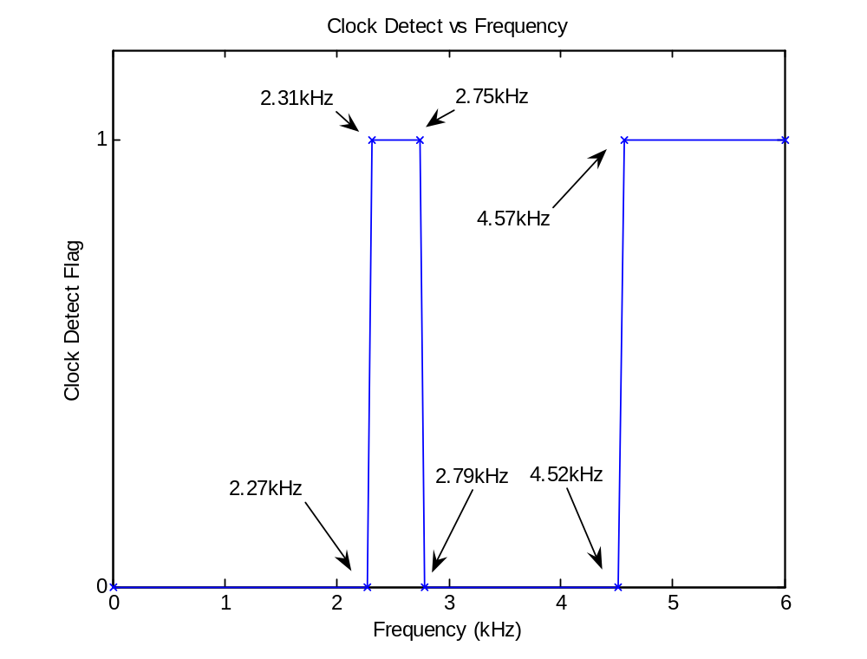
Clock Detection

Slide 20
Software
Manchester Encoding/Decoding
Power Saving Techniques
Dynamic Address Allocation

Slide 21
Scheduled Rendezvous
9am
10am
11am
12pm
1pm
Nodes are awake for 5 minutes every hour
Suits periodic bulk data transfer
Common in data collection applications

Slide 22
Synchronisation
Node A
9am
10am
11am
12pm
1pm
Node B
9am
10am
11am
12pm
1pm
Distributed synchronisation
  Large error tolerance
Clock Drift
  Phase Detection
No connectivity between rendezvous periods
  Preamble sampling

Slide 23
Preamble Sampling
Preamble
Message
Node A
Node X
Node Y
Node Z
Use preamble to wake up other nodes
Frequent brief samples
Keep listening if there is any activity
Preamble length = sampling delay
  Save power while listening
  Use more power when transmitting

Slide 24
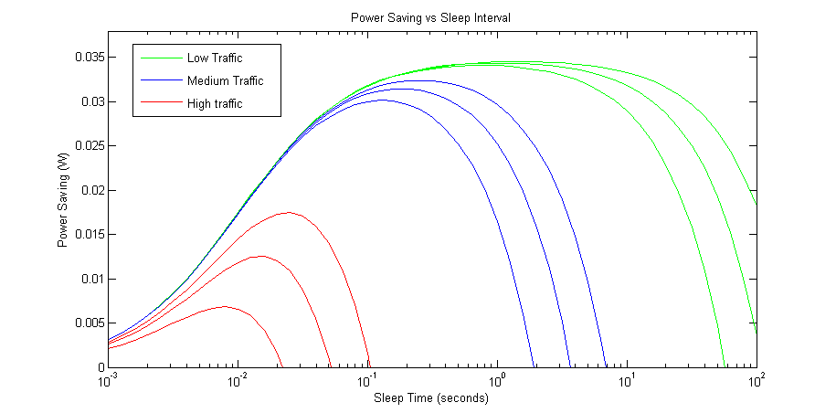
Optimal Sampling Frequency
n=5
n=5
n=20
n=5
n=20
n=50
n=20
n=50
n=50
Optimum sampling frequency depends on node density and traffic level
Very effective for low density and low traffic
Power savings up to 99%

Slide 25


Dynamic Optimisation
DUDE!
What?
Periods of localised increased traffic levels
Dynamically adjust the sampling frequency when increased traffic is anticipated
Reduced chance of collisions

Slide 26
Results
Scheduled Rendezvous:
  Scheduling implemented with RTC chip
  Synchronise two nodes with 1 sec error
Preamble Sampling:
  Implemented and verified
  Maintains connectivity
  Power consumption proportional to duty cycle
Dynamic Optimization
  Basic operation verified
  Future work – use network and application layer information for more intelligence

Slide 27
Software
Manchester Encoding/Decoding
Power Saving Techniques
Dynamic Address Allocation

Slide 28
Dynamic Address Allocation
Traditional methods are centralised
  e.g. DHCP Server
Goals:
  Dynamically allocate unique addresses
  Cope with network dynamics
Three ad hoc addressing techniques:
  Centralised (elected leader)
  Decentralised (distributed agreement)
  Mutually exclusive address spaces

Slide 29
Mutually Exclusive Address Spaces
Every node has a set of mutually exclusive addresses
Every node can give some of its addresses away
Very low overhead
New protocol based upon two existing protocols

Slide 30




Here’s how it works:
I’ll give you 1 address
I don’t want your addresses
2
I want Katie’s addresses
I’ll give you 10 addresses
I want some addresses
I don’t want your addresses
50
0
20
I want your addresses
I’ll give you 50 addresses
50
100

Slide 31
Address Depletion
Hey everyone, Tom wants some addresses
I got nothing
1
Hey everyone, Tom wants some addresses
I want some addresses
I got nothing
0
1
I’ll give you 50 addresses
100

Slide 32

Results
Partially implemented for ns-2 network simulator
Didn’t work
Poor documentation and support
Simulation required to quantify results

Slide 33
Remote Ad Hoc Sensor Networks
Summary

Slide 34
Summary
Hardware improved
  More compact PCB design
  Bypass switch – 500mA reduced to 5uA
Fast, efficient, reliable Manchester codec
  Fully working mate!
Power save protocol working
  Theoretical 99% power saving
  Requires simulation to quantify results
  Identified areas for future improvement
Dynamic address allocation developed
  Implementation needs to be completed
  Requires simulation to verify operation

Slide 35


Slide 36

Questions
Website:
Search for “JCU AD HOC” at www.google.com

